Slide 1

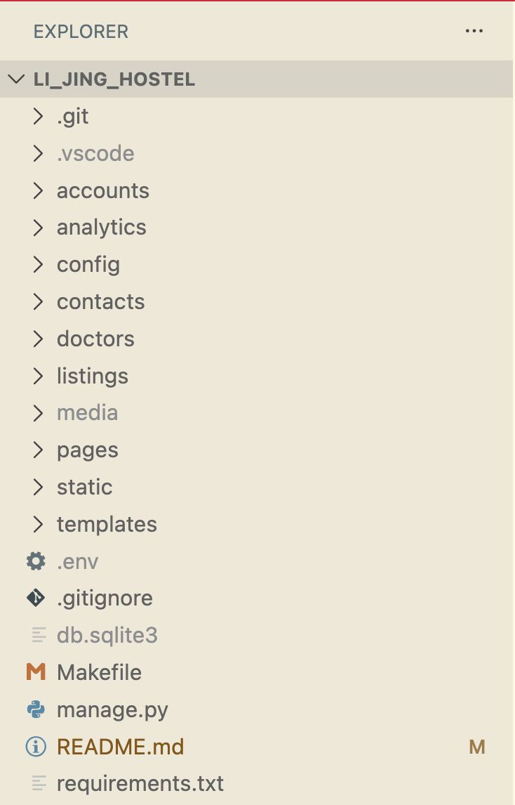
File structure of Li_Jing_Hostel website as at 20251119

Slide 2
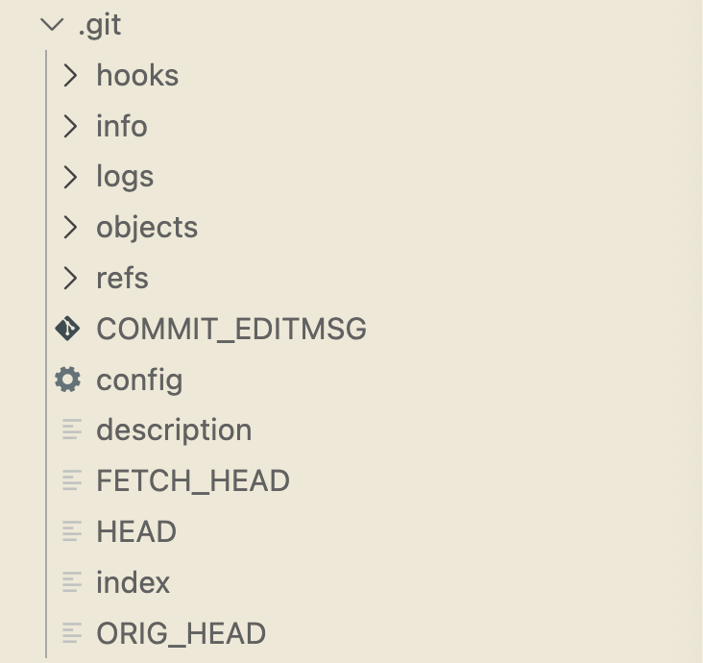
File structure of Li_Jing_Hostel website as at 20251119

Slide 3
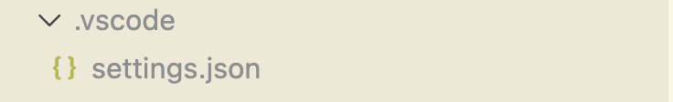
File structure of Li_Jing_Hostel website as at 20251119

Slide 4
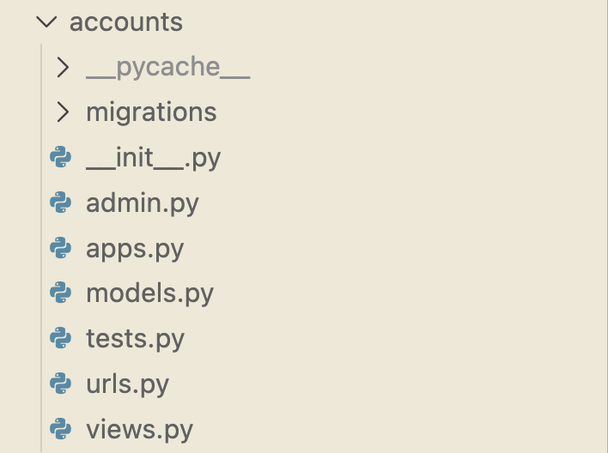
File structure of Li_Jing_Hostel website as at 20251119

Slide 5
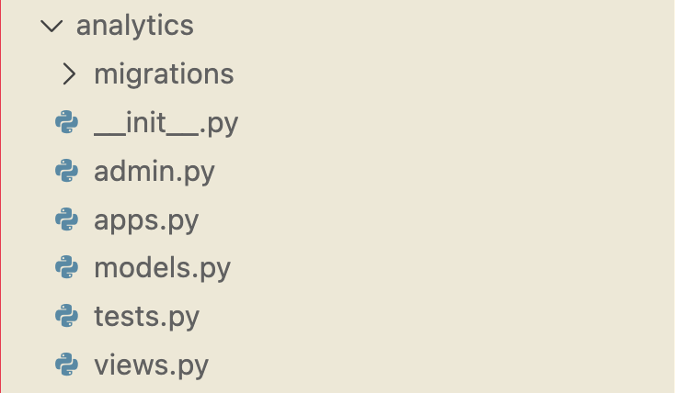
File structure of Li_Jing_Hostel website as at 20251119

Slide 6
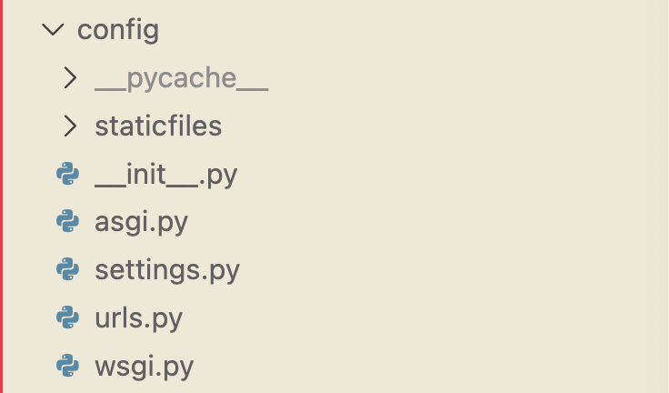
File structure of Li_Jing_Hostel website as at 20251119

Slide 7
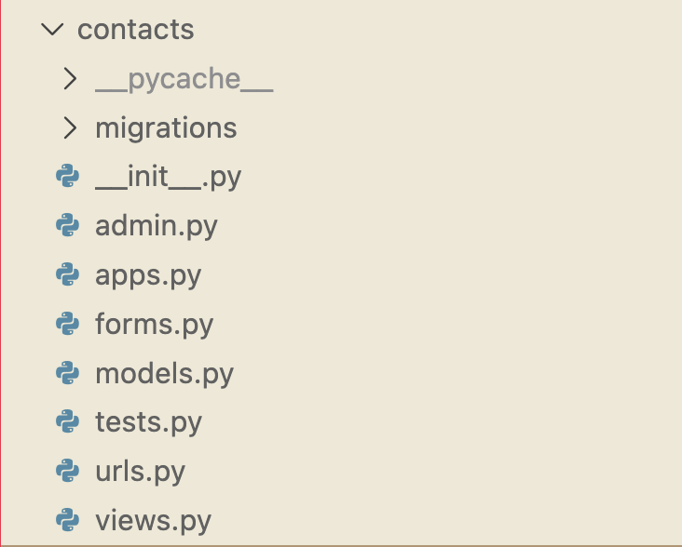
File structure of Li_Jing_Hostel website as at 20251119

Slide 8
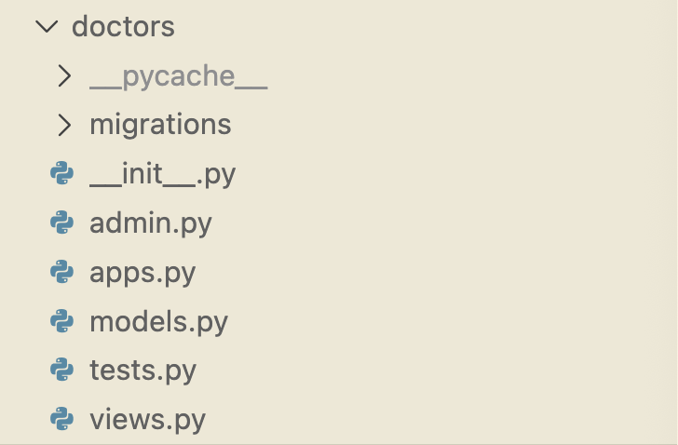
File structure of Li_Jing_Hostel website as at 20251119

Slide 9
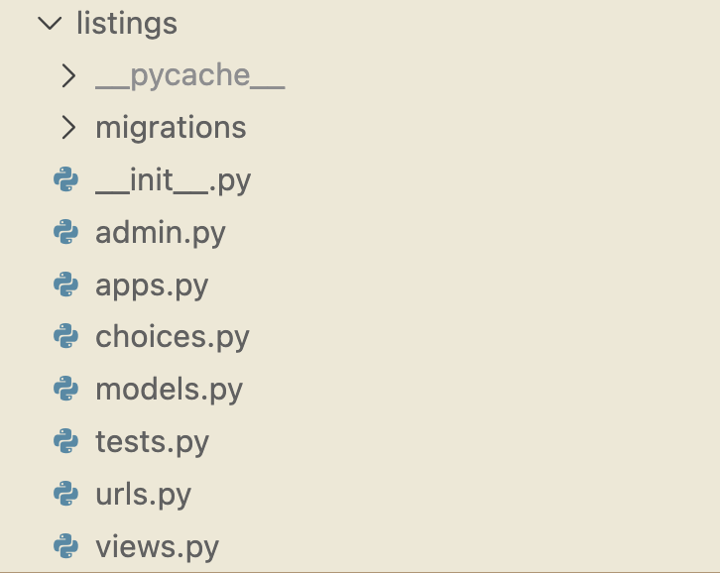
File structure of Li_Jing_Hostel website as at 20251119

Slide 10

File structure of Li_Jing_Hostel website as at 20251119

Slide 11
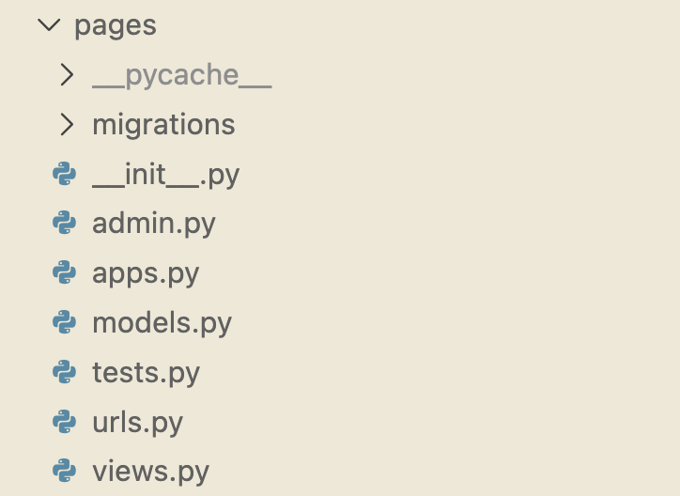
File structure of Li_Jing_Hostel website as at 20251119

Slide 12

File structure of Li_Jing_Hostel website as at 20251119

Slide 13
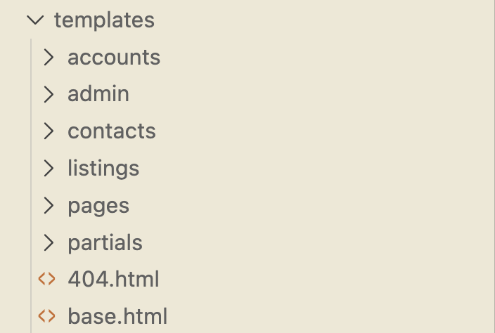
File structure of Li_Jing_Hostel website as at 20251119

